Slide 1
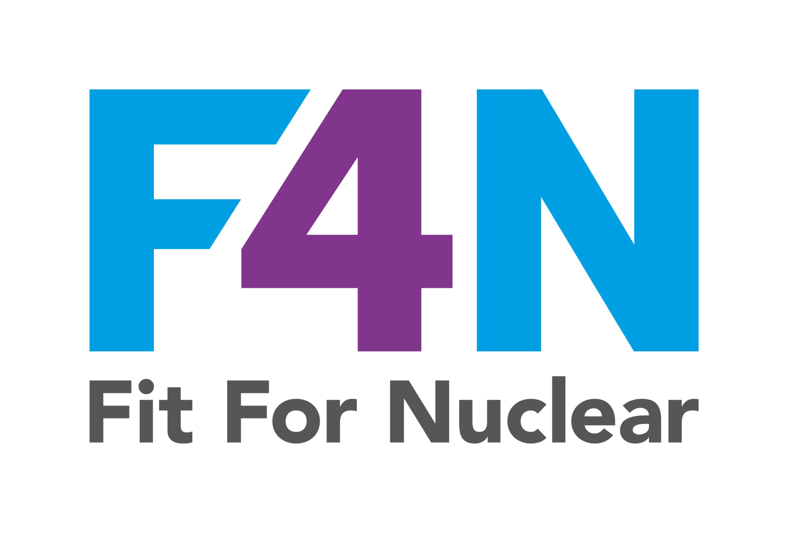


TALK 1 OF 4
Why Human Performance Matters in Nuclear
Talk 1: What HP is, why humans make mistakes, and the eight error traps
NucCol | Nuclear Collaboration Ltd · Fit For Nuclear Programme · Commercial in Confidence | 1

Slide 2

What is Human Performance?
Human Performance (HP) is a discipline that accepts humans are fallible and designs tasks to minimise errors
It is NOT about blaming individuals when things go wrong. It is about creating conditions where errors are caught before they cause harm
HP was developed in nuclear operations and is now a core expectation for the entire nuclear supply chain
Every person working on nuclear contracts is expected to understand and apply HP tools
HP is assessed during F4N NSS assessments and nuclear client audits
HP is not optional extra. It is a professional standard that every nuclear worker is expected to meet.
NSS-05j | TALK 1 OF 4
NucCol | Nuclear Collaboration Ltd · Fit For Nuclear Programme · Commercial in Confidence | 2

Slide 3

Why Mistakes Happen
The nuclear HP framework does not treat errors as character failings. Errors are predictable outcomes of specific conditions
These conditions are called error traps or precursors. Recognising them before a task is the first step in managing them
The same error precursors appear repeatedly in nuclear incident investigations worldwide
Understanding error traps lets us raise our level of care at the right moment, not after something has gone wrong
Recognising a trap does not mean stopping the task. It means applying HP tools more deliberately
Research shows the same eight error traps appear in the majority of nuclear supply chain incidents.
NSS-05j | TALK 1 OF 4
NucCol | Nuclear Collaboration Ltd · Fit For Nuclear Programme · Commercial in Confidence | 3

Slide 4
THE EIGHT NUCLEAR ERROR TRAPS
1. Time Pressure
2. Distraction
3. Habit / Complacency
4. First Time / Infrequent
Schedule drives behaviour: steps get skipped
Interrupted mid-task: lose place, lose focus
Done before: stops actively checking each step
Less practice: more likely to miss something
5. Overconfidence
6. Unclear Procedure
7. Physical Environment
8. Simultaneous Tasks
Experience replaces vigilance
Ambiguity leads to assumptions
Noise, heat, poor lighting reduce performance
Split attention increases error likelihood
NSS-05j | TALK 1 OF 4
NucCol | Nuclear Collaboration Ltd · Fit For Nuclear Programme · Commercial in Confidence | 4

Slide 5
Discussion Scenario
SCENARIO
A team is under pressure to complete a fabrication task before end of shift. It is a job they have done many times before. The supervisor suggests skipping the peer check to save time.
DISCUSS:
Which error traps are active here? What should the team do and why?
NSS-05j | TALK 1 OF 4
NucCol | Nuclear Collaboration Ltd · Fit For Nuclear Programme · Commercial in Confidence | 5

Slide 6
Errors happen. That is human. What we do about them is what makes us nuclear-ready.
NSS-05j | TALK 1 OF 4
NucCol | Nuclear Collaboration Ltd · Fit For Nuclear Programme · Commercial in Confidence | 6

Slide 7
TALK 2 OF 4
Pre-Job Briefing and Self-Check (STAR)
Talk 2: HP-1 and HP-2 in practice
NucCol | Nuclear Collaboration Ltd · Fit For Nuclear Programme · Commercial in Confidence | 7

Slide 8

Pre-Job Briefing (HP-1): What It Is
A pre-job briefing is a structured discussion before every nuclear-significant task. Not a quick chat. A deliberate process.
It ensures everyone knows: exactly what is to be done, in what order, to what standard, and with what controls in place
It identifies error traps relevant to this specific task, not generic ones
It confirms hold/witness points, contingency actions, and stop-work criteria before work starts
For Grade 1/2 work it is recorded using the Pre-Job Briefing Template (NSS-05c) and retained as a quality record
The quality of the pre-job briefing is the single biggest predictor of whether HP tools are used well during the task that follows.
NSS-05j | TALK 2 OF 4
NucCol | Nuclear Collaboration Ltd · Fit For Nuclear Programme · Commercial in Confidence | 8

Slide 9
Pre-Job Briefing (HP-1): The Eight Elements
1. Task scope and sequence: what exactly is being done, in what order
2. Procedure revision: confirm the correct and current procedure is being used
3. Nuclear safety significance and quality grade
4. Error traps relevant to THIS task: time pressure? First time? Noisy environment?
5. Hold and witness points: who must be notified and when
6. Contingency actions: what to do if something unexpected happens
7. Stop-work criteria: at what point does work stop and who is called
8. Attendee sign-off: everyone confirms they understood before work begins
An 8-minute pre-job briefing conducted properly is worth more than any amount of paperwork completed after an error.
NSS-05j | TALK 2 OF 4
NucCol | Nuclear Collaboration Ltd · Fit For Nuclear Programme · Commercial in Confidence | 9

Slide 10

Self-Check (STAR): HP-2
STAR stands for: Stop, Think, Act, Review
STOP: pause before the action. Do not proceed on autopilot
THINK: confirm the action, the expected result, and what could go wrong
ACT: perform the action deliberately and with full attention
REVIEW: check immediately that the expected result was achieved before moving to the next step
STAR is used before any safety-significant action, especially irreversible ones, and at every hold point
STAR is the individual's most personal HP tool. Nobody can do it for you. It is a mental habit that saves errors.
NSS-05j | TALK 2 OF 4
NucCol | Nuclear Collaboration Ltd · Fit For Nuclear Programme · Commercial in Confidence | 10

Slide 11
Discussion Scenario
SCENARIO
A welder is working through a multi-step procedure. Partway through, a colleague calls over with a question. The welder stops, answers the question, and returns to the work.
DISCUSS:
How does the welder use HP-2 (Self-Check STAR) when resuming? What should they specifically do before carrying on?
NSS-05j | TALK 2 OF 4
NucCol | Nuclear Collaboration Ltd · Fit For Nuclear Programme · Commercial in Confidence | 11

Slide 12
A good pre-job briefing and a disciplined STAR habit stop more errors than any inspection activity ever will.
NSS-05j | TALK 2 OF 4
NucCol | Nuclear Collaboration Ltd · Fit For Nuclear Programme · Commercial in Confidence | 12

Slide 13
TALK 3 OF 4
Peer Check, Three-Way Communication, and Place Keeping
Talk 3: HP-3, HP-4, and HP-5
NucCol | Nuclear Collaboration Ltd · Fit For Nuclear Programme · Commercial in Confidence | 13

Slide 14
Peer Check (HP-3)
A peer check is NOT the same as someone looking over your shoulder and agreeing with you
The checker independently evaluates the action or result BEFORE it is confirmed
The checker must not see the first person's finding before forming their own independent view
If the two findings agree: proceed. If they disagree: STOP and resolve before any action is taken
Peer checks are used for Grade 1/2 activities, irreversible actions, and any task where an error precursor has been identified
Both the doer and checker record their involvement in the relevant quality record
Independence is the point. A peer check where both people look together and nod is not a peer check.
NSS-05j | TALK 3 OF 4
NucCol | Nuclear Collaboration Ltd · Fit For Nuclear Programme · Commercial in Confidence | 14

Slide 15

Three-Way Communication (HP-4)
Three-way communication confirms mutual understanding of any safety-significant verbal instruction
Step 1: Sender states the information or instruction clearly
Step 2: Receiver repeats back the information in their own words
Step 3: Sender confirms the repeat-back is correct, or corrects it
If any uncertainty remains after the repeat-back: repeat from the beginning
Use for: hold point status, stop-work instructions, procedure step changes, shift handovers
Three-way communication feels formal at first. After a while it feels natural. It catches misunderstandings that cause real incidents.
NSS-05j | TALK 3 OF 4
NucCol | Nuclear Collaboration Ltd · Fit For Nuclear Programme · Commercial in Confidence | 15

Slide 16
Place Keeping (HP-5)
Place keeping physically marks position in a multi-step procedure so no step can be skipped or repeated
Mark each completed step on the procedure document before moving to the next
Never rely on memory alone, especially during a long or complex procedure
If interrupted: mark the last completed step before stopping
On resuming: verify position from the marking before continuing, not from memory
Never skip a step even if it seems unnecessary: complete or formally defer each step in sequence
Place keeping is especially important when interruptions are likely. In a busy fabrication environment, they always are.
NSS-05j | TALK 3 OF 4
NucCol | Nuclear Collaboration Ltd · Fit For Nuclear Programme · Commercial in Confidence | 16

Slide 17
Discussion Scenario
SCENARIO
A quality inspector is conducting a dimensional check on a nuclear component with 12 measurement points. Halfway through, they are called away briefly to deal with a delivery query. They return five minutes later.
DISCUSS:
Which two HP tools from this talk are most relevant here? Describe what the inspector should do before continuing the inspection.
NSS-05j | TALK 3 OF 4
NucCol | Nuclear Collaboration Ltd · Fit For Nuclear Programme · Commercial in Confidence | 17

Slide 18
HP-3, HP-4, HP-5. Three tools that turn individual attention into collective reliability.
NSS-05j | TALK 3 OF 4
NucCol | Nuclear Collaboration Ltd · Fit For Nuclear Programme · Commercial in Confidence | 18

Slide 19
TALK 4 OF 4
Stop-Work Authority and Concurrent Verification
Talk 4: HP-6 and HP-7, and putting it all together
NucCol | Nuclear Collaboration Ltd · Fit For Nuclear Programme · Commercial in Confidence | 19

Slide 20
Concurrent Verification (HP-6)
Concurrent verification: two people simultaneously and independently verify a critical measurement, safety setting, or system state
Neither person tells the other their result before they have each independently reached their own conclusion
Both then state their findings. If they agree: verified. If they disagree: STOP before any action is taken
The key word is independently: looking at the same thing together is NOT concurrent verification
Used where a single verification carries an unacceptably high consequence of error: safety-critical measurements, Grade 1 accept/reject decisions
The difference between concurrent verification and a peer check: both parties form their view independently at the same time, without any communication until they have both concluded.
NSS-05j | TALK 4 OF 4
NucCol | Nuclear Collaboration Ltd · Fit For Nuclear Programme · Commercial in Confidence | 20

Slide 21

Stop-Work Authority (HP-7): The Most Important Tool
Every person working on a nuclear contract has the right and RESPONSIBILITY to stop any task at any time
The threshold is a concern, not certainty of an error. If something does not seem right: STOP
Stop-work authority cannot be overridden by schedule, commercial pressure, or seniority
State the concern clearly. Do not proceed past the point of concern. Escalate to the Nuclear Quality Lead
The task does not restart until the concern has been investigated and resolved by an authorised person
Log the stop-work event. Use it as learning. Stopping work is a professional act, not a failure
An organisation that penalises stop-work calls will quickly stop hearing them. Then events happen instead.
NSS-05j | TALK 4 OF 4
NucCol | Nuclear Collaboration Ltd · Fit For Nuclear Programme · Commercial in Confidence | 21

Slide 22
Putting All Seven Tools Together
HP-1 Pre-Job Briefing: before every nuclear-significant task
HP-2 Self-Check (STAR): before every safety-significant action
HP-3 Peer Check: for Grade 1/2 work and irreversible actions
HP-4 Three-Way Communication: for safety-significant instructions and handovers
HP-5 Place Keeping: throughout every multi-step procedure
HP-6 Concurrent Verification: for critical measurements with high consequences of error
HP-7 Stop-Work Authority: any time, any person, any concern. Non-negotiable.
Reference card NSS-05b has all seven at a glance for use at your workstation
Seven tools. Used together, consistently, on every nuclear-significant task. That is what a human performance programme looks like in practice.
NSS-05j | TALK 4 OF 4
NucCol | Nuclear Collaboration Ltd · Fit For Nuclear Programme · Commercial in Confidence | 22

Slide 23
Discussion Scenario
SCENARIO
A team has completed their pre-job briefing and started work. Midway through, the person performing a Grade 1 final check notices that the measurement result is 0.05mm outside the drawing tolerance. The supervisor says the tolerance is probably conservative and suggests pressing on.
DISCUSS:
Which HP tools apply here? Who has authority to decide what happens next?
NSS-05j | TALK 4 OF 4
NucCol | Nuclear Collaboration Ltd · Fit For Nuclear Programme · Commercial in Confidence | 23

Slide 24
Seven tools. Seven habits. The difference between a near miss and a nuclear safety event.
NSS-05j | TALK 4 OF 4
NucCol | Nuclear Collaboration Ltd · Fit For Nuclear Programme · Commercial in Confidence | 24

